Slide 1


Enrollment Center
2017 At A Glance
Enrollment Center Overview
Two permanent sites (NJ & FL)
700+ call center seats
Year-Round full-time team of 80+ consisting of counselors, quality assurance and management support
Licensed and non-licensed counselors available
Bi-lingual (Spanish/English) counselors on site. All calls requiring additional language support are handled by our Language Line Service
State of the art quality program with consistent monitoring and coaching by our dedicated QA team
259,000
Calls answered
112,000
Enrollment Events
Average Talk Time
19 Minutes
OE 21 Minutes
Perpetual 17 Minutes
Operational Tools
Manager and Counselor Desktops with online reference material
Inbound and outbound call recording
Call Back Manager offers employees the option to be called back and lessens their time spent on hold waiting for an agent
Outbound dialer strategies and call-in schedules developed to encourage level call volume and reduce peaks enhancing employee experience
89%
Quality Evaluation
Average Score
OE 88%
Perpetual 90%

Slide 2
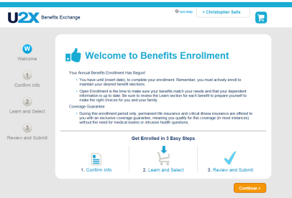
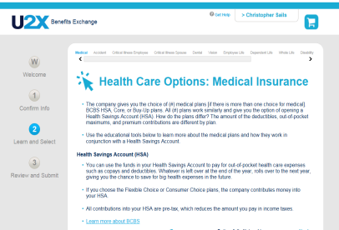

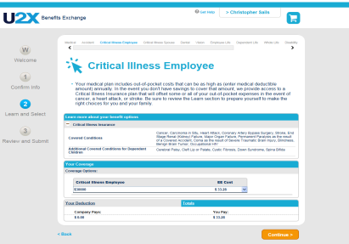
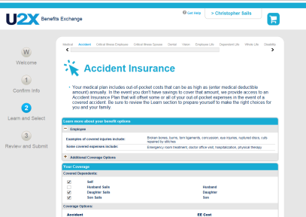
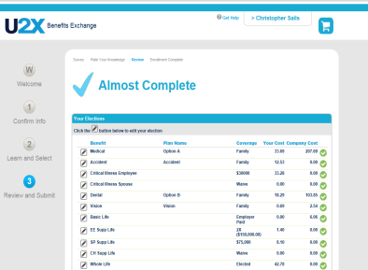
Enrollment Center – Sample Call
Greeting and Call Expectations
Medical Enrollment
Maintains a professional tone
Verifies purpose of the call
Provides benefit options
Explains plan details and out of pocket expenses
Voluntary Benefit Enrollment
Closing
Explains value of voluntary benefits
Discusses financial risk
Checks for understanding
Asks if additional assistance is needed
Closes call professionally

Slide 3
Aon Quality Assurance
QA Preparation
Onboarding Orientation
Benefits
Call-Flows & Best Practices
VB Presentation Skills
Technology Tools
Case Training
Client Specifics
Company Culture
Calibrations
Call Evaluations
Call Criteria
Call Procedures & Handling
Benefits
Core & Voluntary Education
Benefit Discussions & Enrollment Services
VB Incorporation
Customer Service
Compliance
Weighting & Range Scoring
Call Notes
Frequency
Coaching & Feedback
Regular 1-1 coaching sessions
Progress Reports
Listening Sessions
Performance Management

Slide 4
2017 Quality Assurance at a Glance
Average Call
Quality Evaluation
89%
Open Enrollment: 88%
New Hire Enrollment: 90%
Performance Splits
3,500
Calls Evaluated
Client Escalations
935
Total Escalations
0.8%
Escalation Rate (of total seen)
0.1%
Error Rate (of total calls)

Slide 5
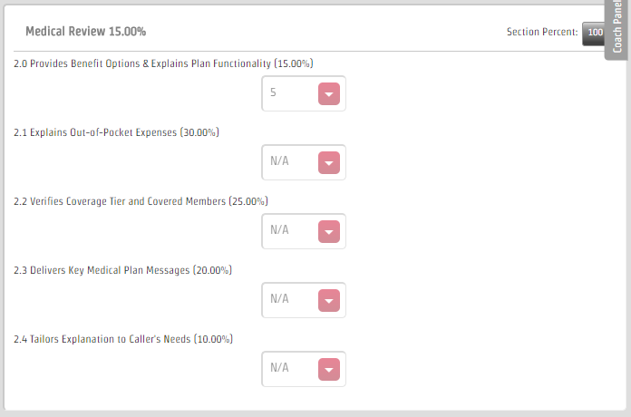
Aon Quality Assurance

Slide 6
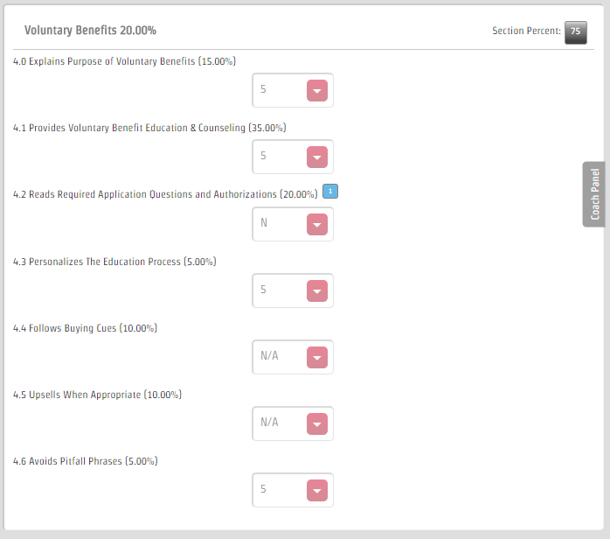
Aon Quality Assurance

